Slide 1
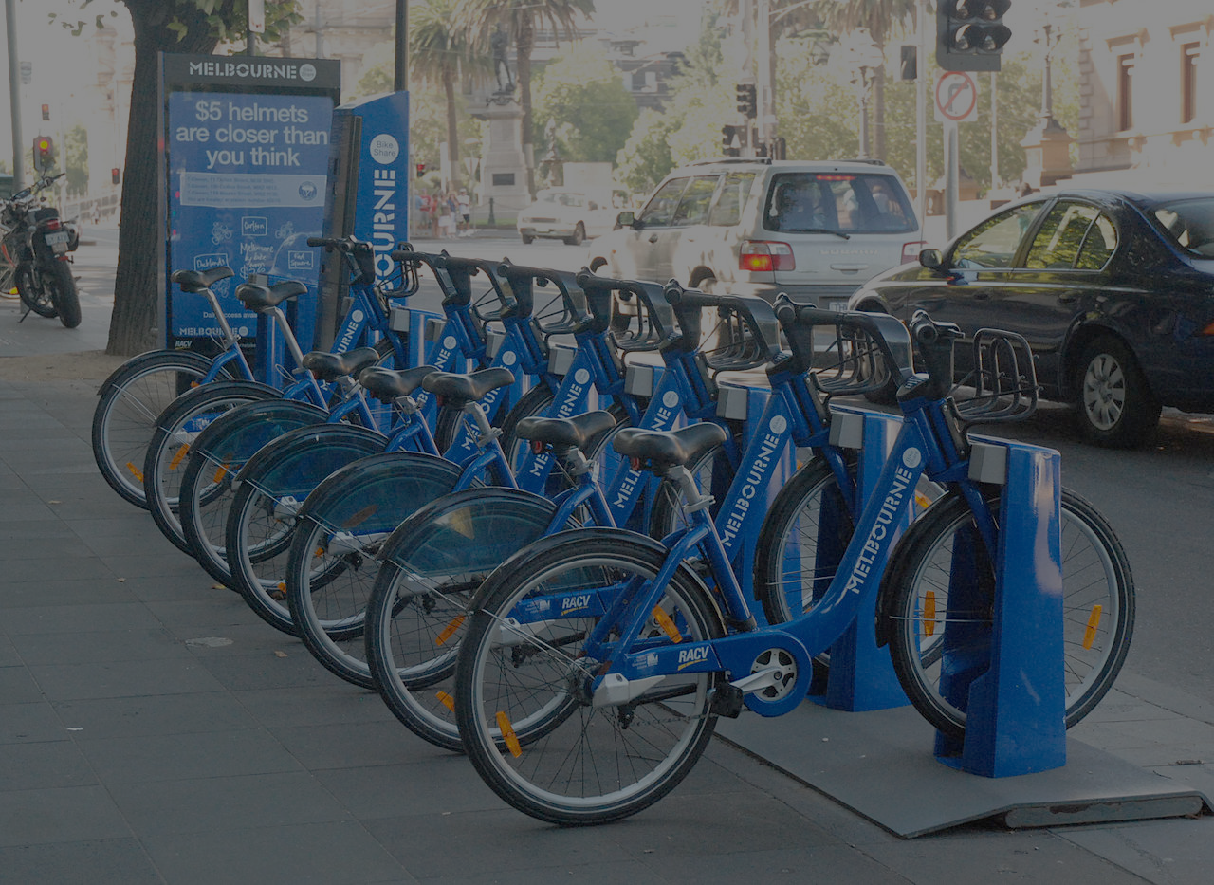
BICYCLE SHARING SYSTEM
Submitted by
1. Hosaain, Farhana Anwar - 17-34666-2

Slide 2
Problems
Traffic systems
Traffic congestion
Vehicle emission
Traffic jam

Slide 3
Existing Solution
In Guanzhou, China the privately operated Guanzhou Bus rapid transit system includes public bicycle system.
As of January 5, 2013, with 66,500 bicycles operating from 2,700 stations, it was the largest bike sharing system in the world, although it has since been overtaken by a number of dockless bike share operators such as Mobike.
Due to growing motorized traffic congestion and concerns over the environment, the Hangzhou Public Transport Corporation launched bike-sharing on May 1, 2008, initially starting with 2,800 bicycles, 30 fixed stations, and 30 mobile stations.

Slide 4
Proposed Solution
The purpose of the Bangladesh bike-sharing system is to provide a free public bike system network for residents and tourists.
The bikes act as a feeder into its public transit network.
Bangladesh bike-sharing uses the concept of the last mile (or the last kilometer) to make sure that users can easily get from public transit stops to their destinations through bikes to complete their journey.
Bicycle-sharing systems are an economic good, and are generally classified as a private good due to their excludable and rivalrous nature.

Slide 5
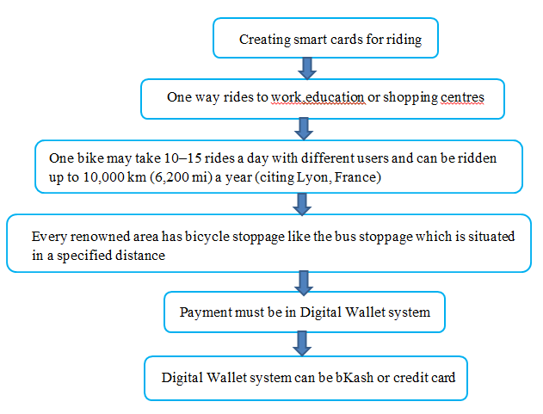
Working Process

Slide 6
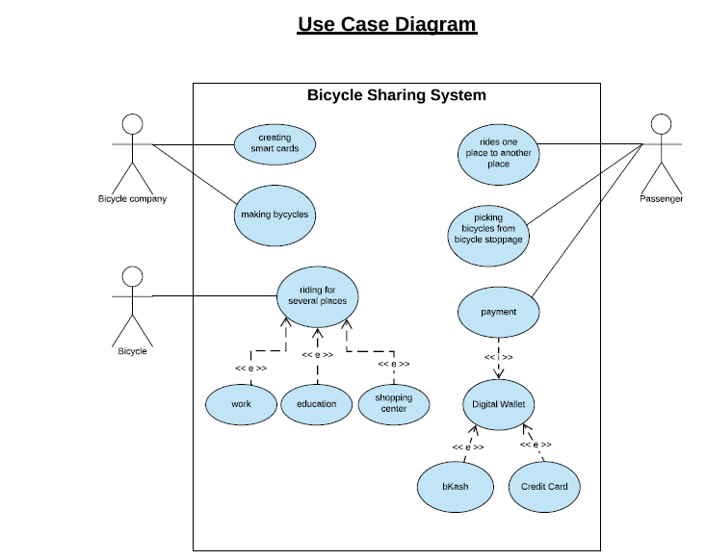
Use Case Diagram

Slide 7
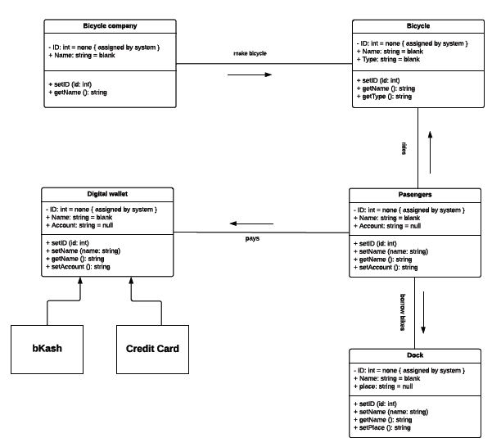
Class Diagram

Slide 8
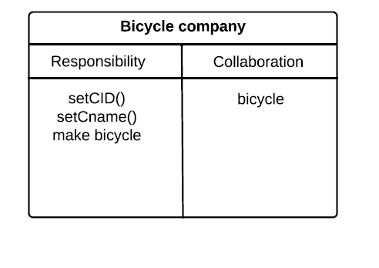
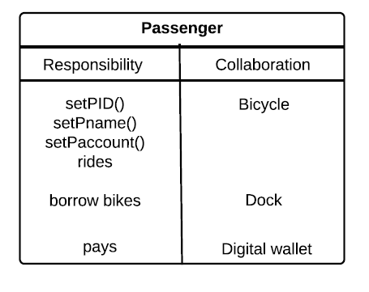
CRC Card

Slide 9
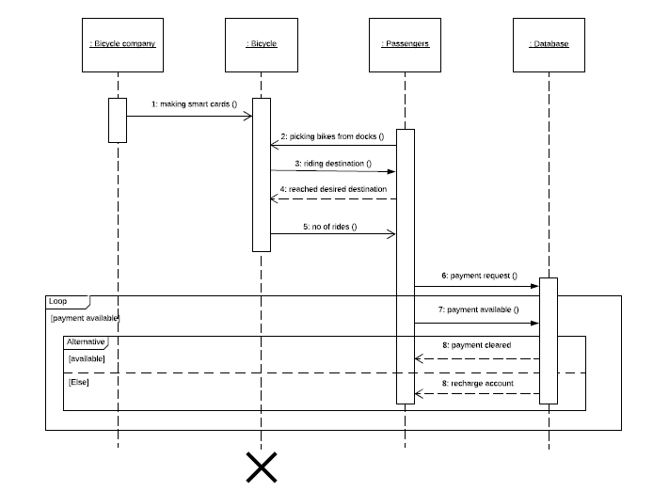
Sequence Diagram

Slide 10
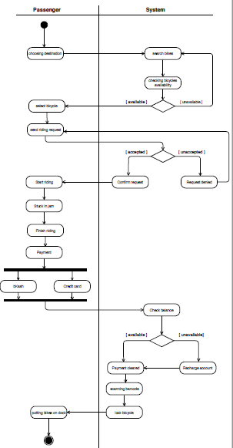
Activity Diagram

Slide 11
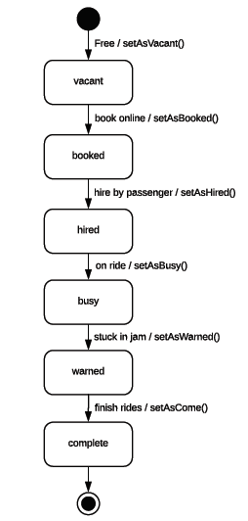
Statechart Diagram

